Slide 1

SELF BALANCING ROBOT
Noor hasan ahmed,MS, embedded systems
Shivaram Nikhil yella,MS, embedded systems
Mohammad amer ahsan,MS, ECE
Ece 5415 Microcontroller based control systems Professor hamzeh alzubi

Slide 2
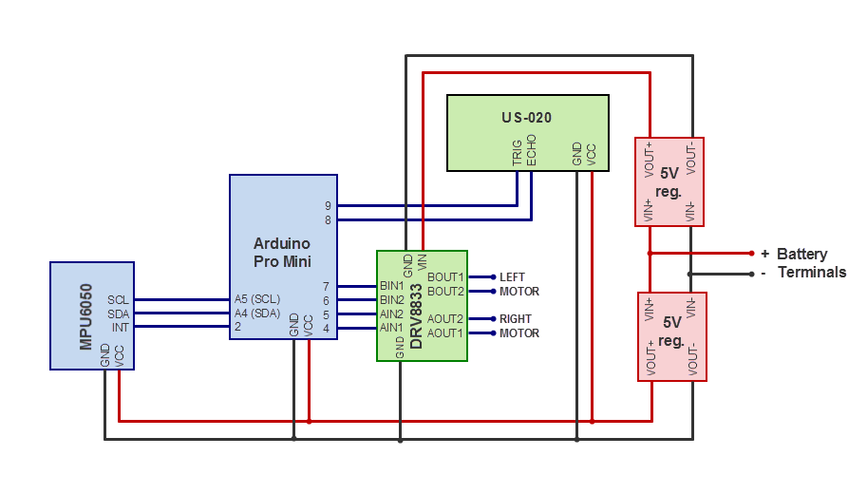
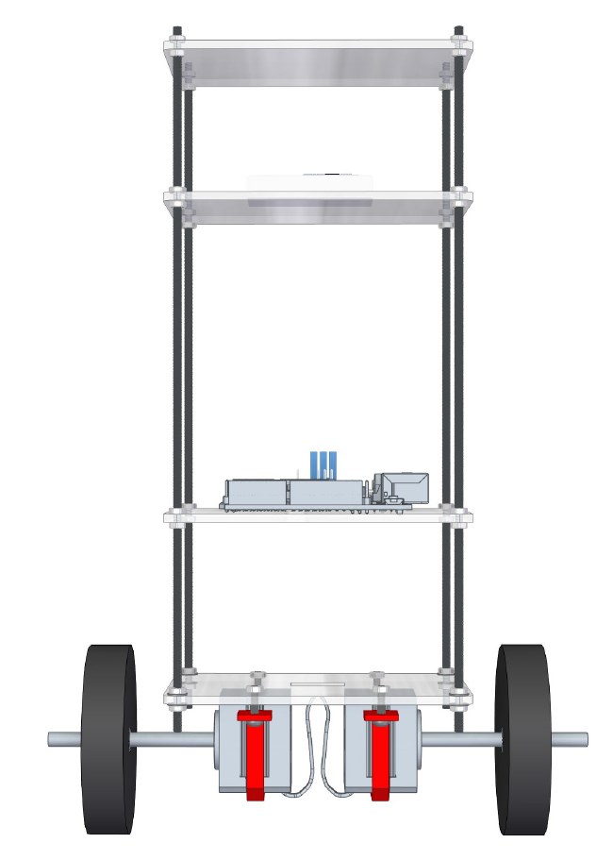
SCHEMATICS

Slide 3
OBJECTIVES
The primary objective of this project is to design, build, and program a self-balancing robot utilizing Arduino-based hardware and various sensors. The specific objectives include:
Control Algorithm Development: Design and implement control algorithms, notably the Proportional-Integral-Derivative (PID) controller, to interpret sensor data, calculate the appropriate motor commands, and maintain the robot's balance in real-time.
System Integration: Integrate the selected hardware components, including motors, wheels, sensors, and the Arduino microcontroller, into a cohesive robotic platform.
Testing and Optimization: Conduct rigorous testing and iteration to optimize the performance of the self-balancing robot, including fine-tuning PID controller parameters and addressing any hardware or software limitations.

Slide 4
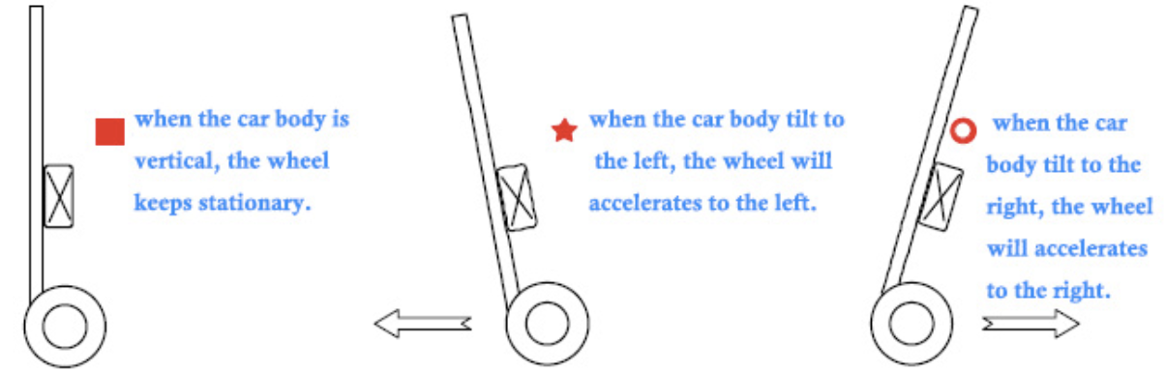
IDEA
Idea
MPU6050 module: Accelerometer + gyroscope. Basically MEMS
TB6612FNG Motor Driver module: Driver IC for Dual DC motor
GA37-520 DC geared motor. Comes with encoder for more precise control.

Slide 5
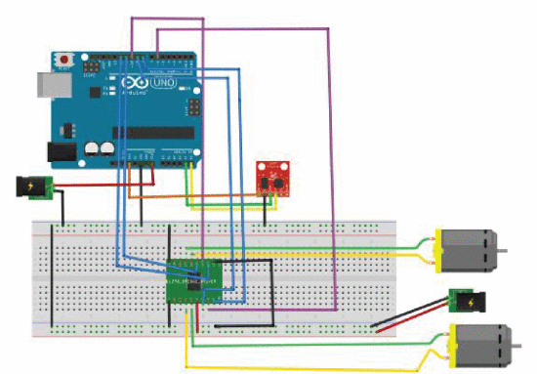
IDEA
MPU6050 module: Accelerometer + gyroscope. Basically MEMS
TB6612FNG Motor Driver module: Driver IC for Dual DC motor
GA37-520 DC geared motor. Comes with encoder for more precise control.
We did replace the Uno with a smaller form factor nano to manage the center of mass.

Slide 6
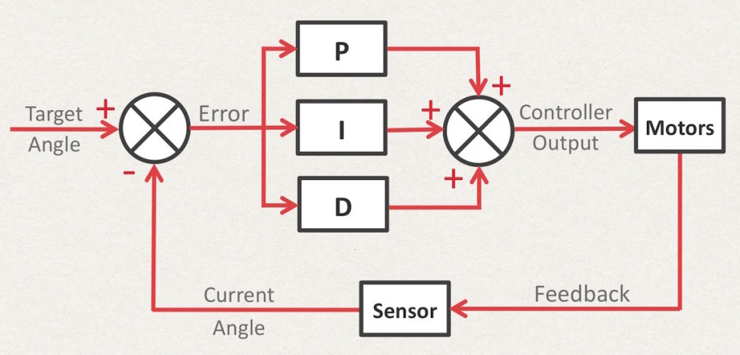
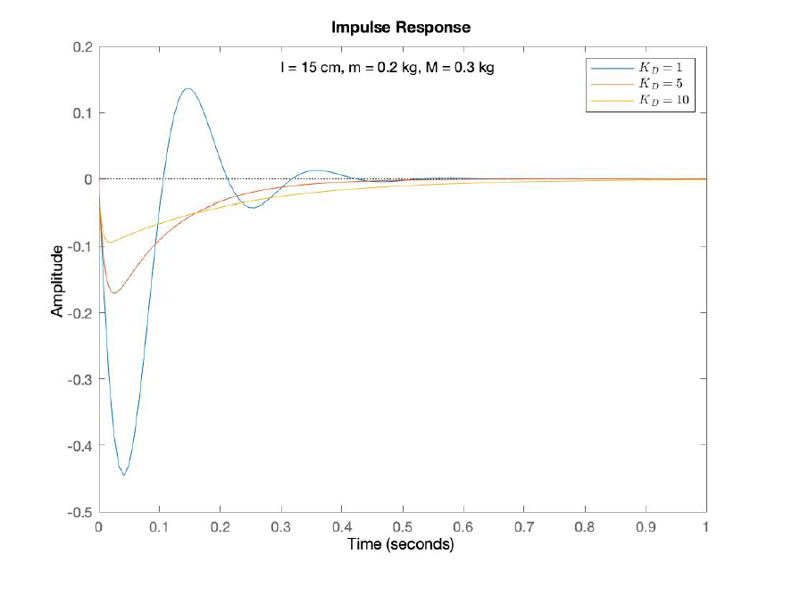
PID CONTROLLER

Slide 7
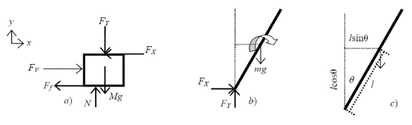
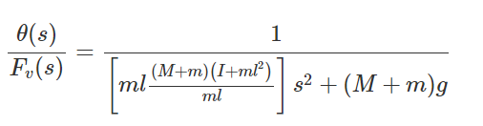
MATHEMATICAL MODELING
Reference:
Design and Implementation of Two-Wheeled Self-Balancing Robot Using PID Controller
Authors: A.Taifour Ali; Ahmed M. O. Mohamedy; Asad S. A. Salimz; El-Amin O. M. El-Aminx; Osman M. K. Ahmed https://ieeexplore.ieee.org/document/9429579
Reference:
Design and Implementation of Two-Wheeled Self-Balancing Robot Using PID Controller
Authors: A.Taifour Ali; Ahmed M. O. Mohamedy; Asad S. A. Salimz; El-Amin O. M. El-Aminx; Osman M. K. Ahmed https://ieeexplore.ieee.org/document/9429579

Slide 8
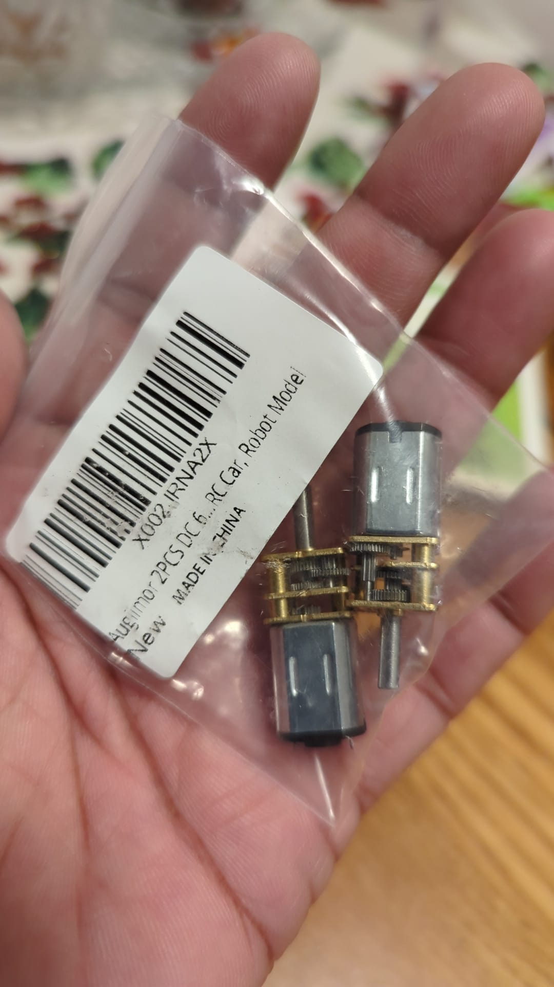
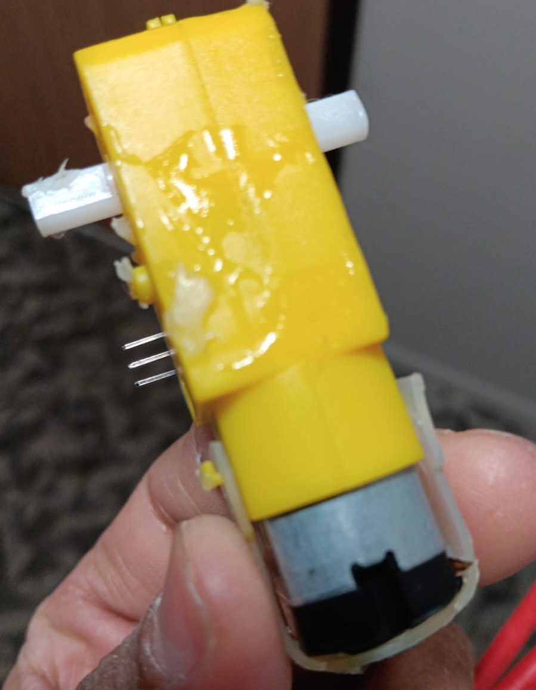
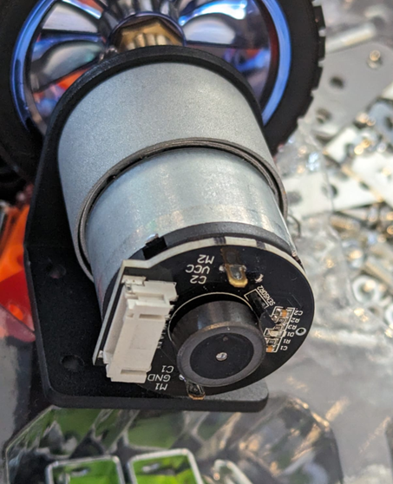
PROGRESS: HARDWARE
Where we started
WHERE WE WERE
Where we are

Slide 9
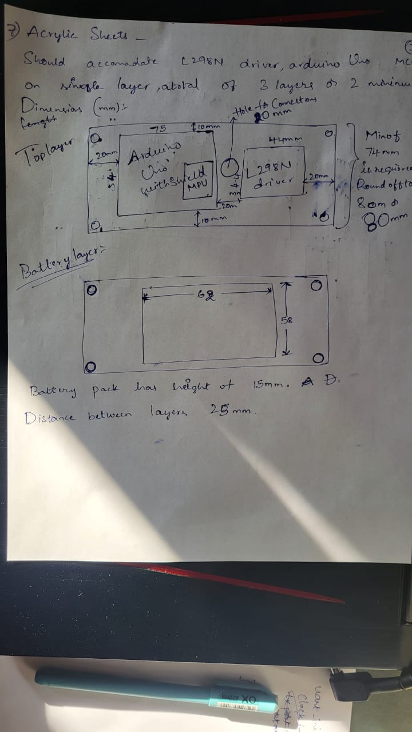
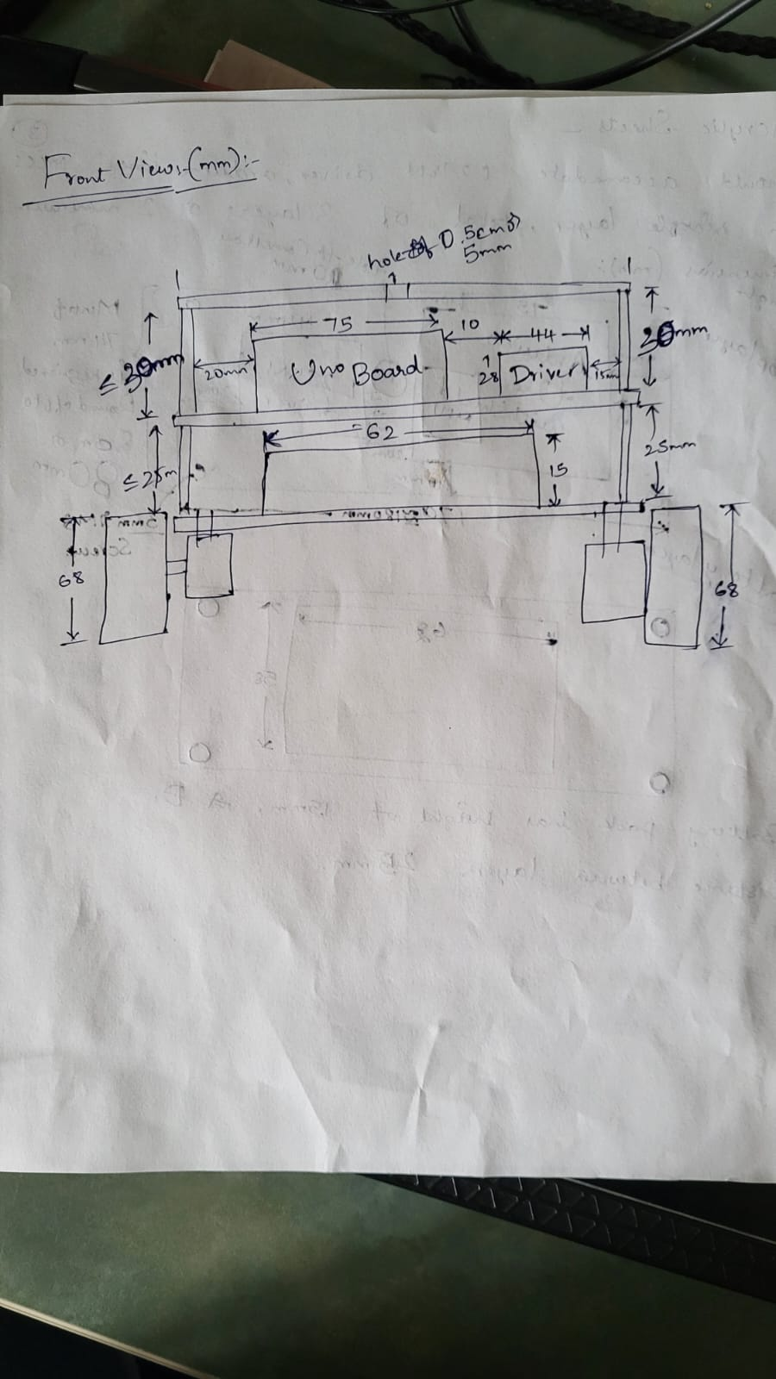
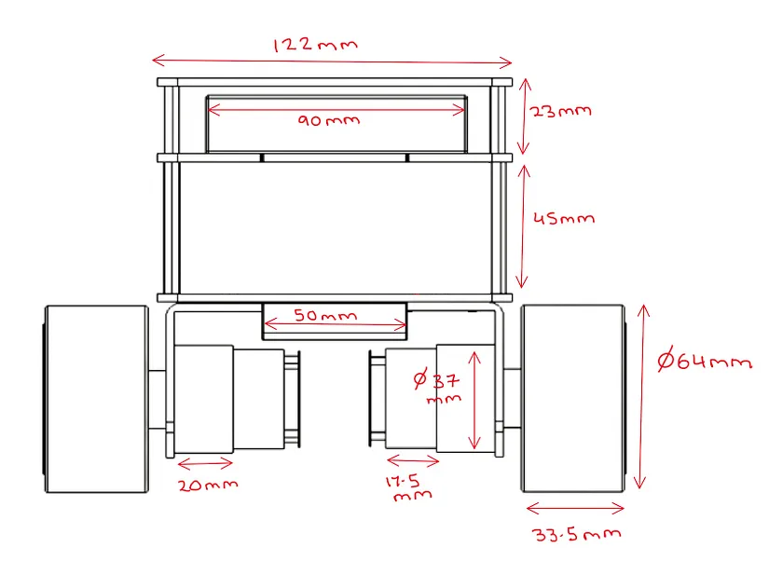
PROGRESS: HARDWARE
Where we started
WHERE WE WERE
Where we are

Slide 10
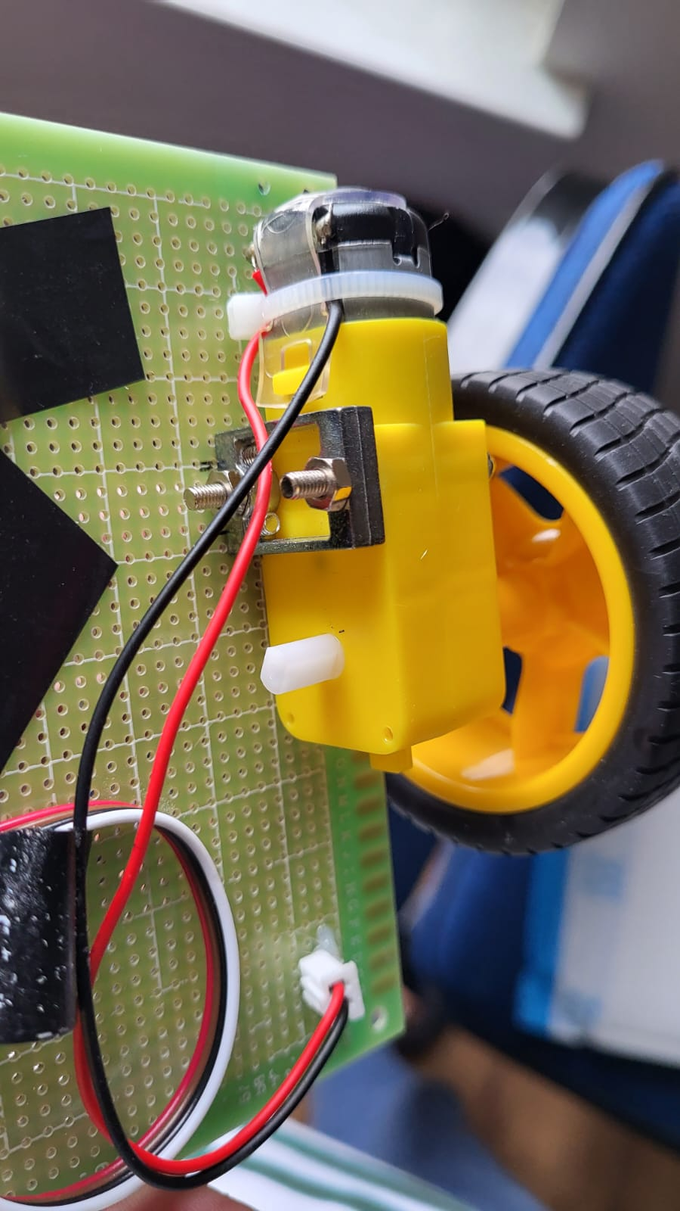
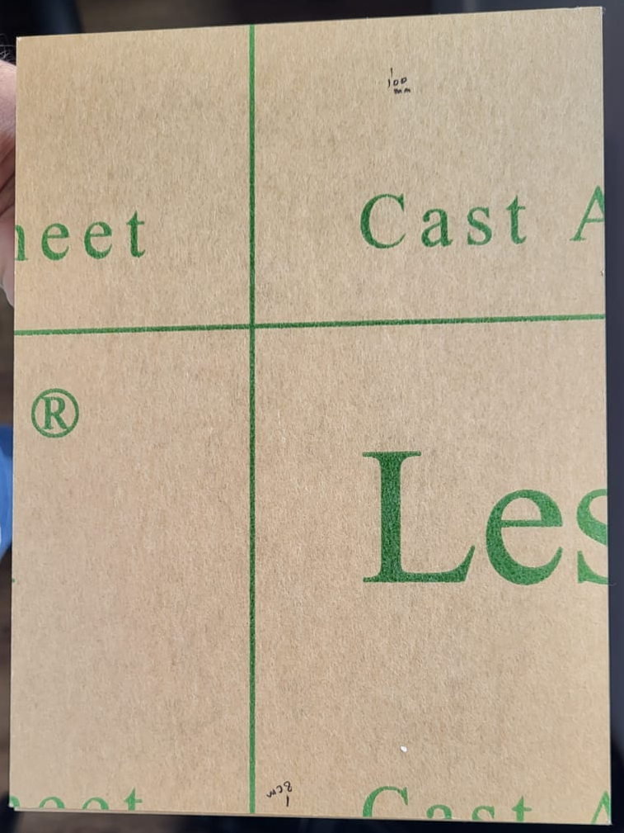
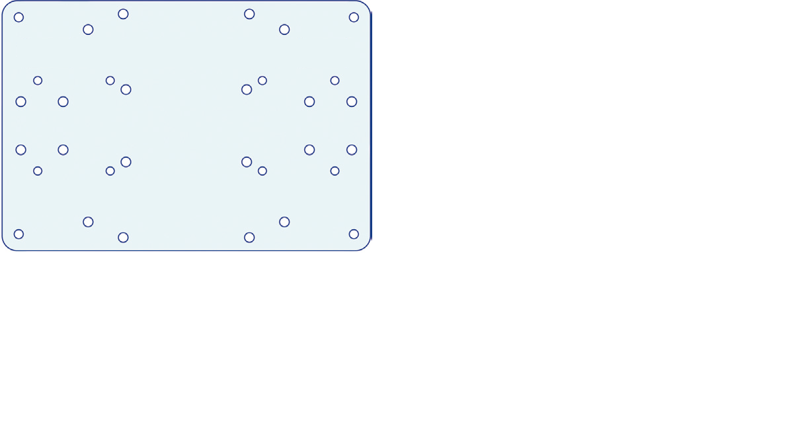
PROGRESS: HARDWARE
Where we started
WHERE WE WERE
Where we are

Slide 11
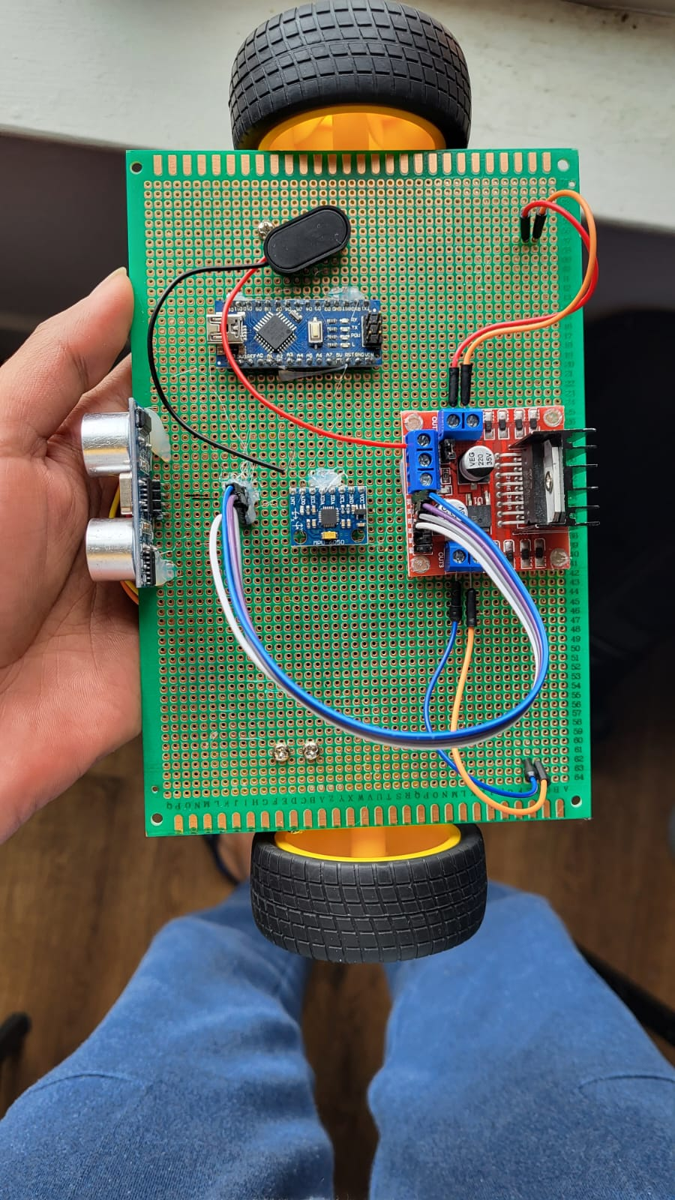
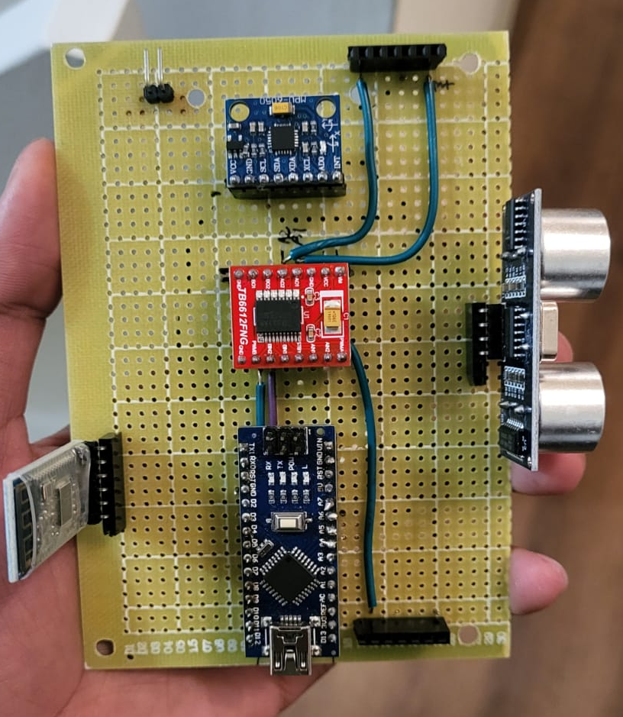
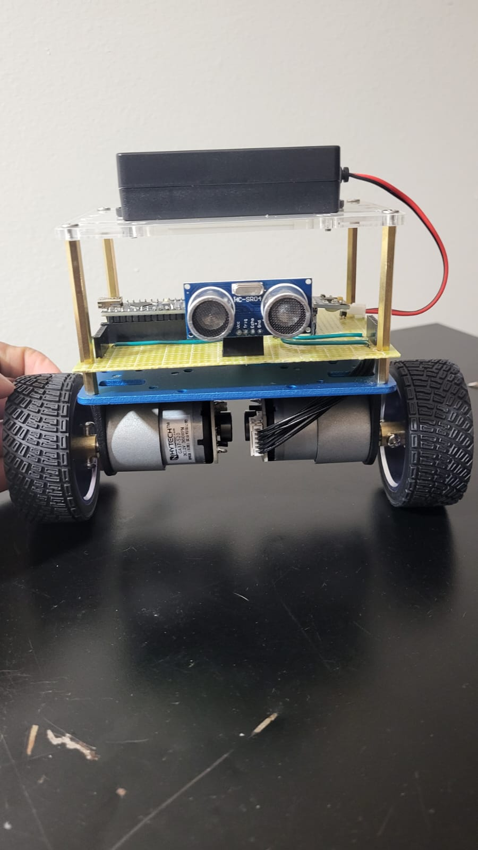
PROGRESS: HARDWARE
Where we started
WHERE WE WERE
Where we are

Slide 12
COMPONENTS
Arduino Starter Kit UNO R3.
GY-521 MPU-6050 IMU sensor
HC-SR04 Ultrasonic sensor
HC-05 Bluetooth Module
NCR18650 battery
DC 12V GA37-520 Geared motor with encoder
42x19mm wheels Prototype PCB (4x6 cm)
Soldering iron

Slide 13

SCHEDULE : WHERE WE ARE

Slide 14
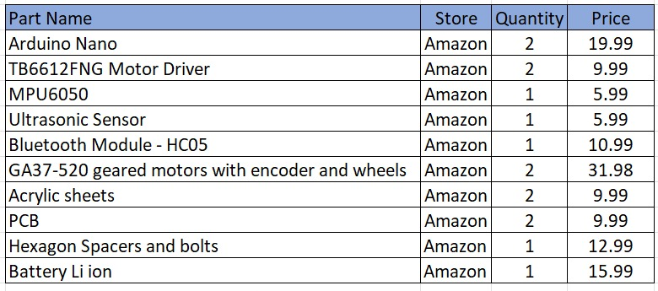
PROJECT MANAGEMENT
Cost: We are counting to $150 approx. Meets out initial estimate.
Man-hours: We have managed to save significant time due to collaboration with Mechanical Dept and Amazon/ebay!
Efforts: Physical design aspects were challenging. We did get some help from ECE and Mechanical Labs in OU.

Slide 15
CONCLUSION
Positives:
We have complete hardware, tested and working.
We have good starting point of chassis and non-electronics items.
We got good help from our friends in mechanical dept in designing and developing chassis board.
We have good starting and almost stable code.
Amazon!!! What would we do without you!
Not So Positive:
We are running late on software completion.
We had to change the assembly multiple times.

